Slide 1
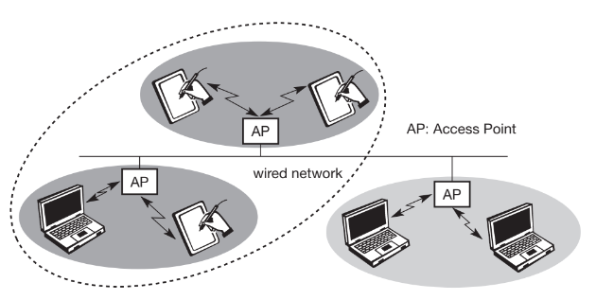
Wireless Local Area Networks: Infrastructure Network
All access points are directly connected with each other.
Two wireless nodes can’t directly communicate with each other.
Direct comm b/w wireless node and AP is possible.
AP acts as a bridge b/w two wired or wireless networks.
Design of Infrastructure based wireless network is simple.
Medium access control mechanism is implemented in AP so that collision doesn’t occur.

Slide 2
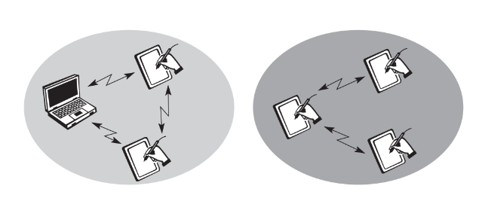
Wireless Local Area Networks: Ad-hoc Network
Infrastructure is not required.
Each node can directly communicate with other node.
No AP is required.
Nodes can’t communicate with e/o if they are not in the network or range.
Complexity of each node is higher.

